Slide 1
How the pandemic changed you and your community.
Aġġornament tal-Kleru - June 2021

Slide 2
An 11-year-old patient of mine changed abruptly from an outgoing, confident boy to an anxious, fearful one after his father developed COVID-19. He now wakes in the middle of the night crying and follows his mother around the house all day.
The Chicago Tribune

Slide 3

The New Realities
Working from home
Temporary unemployment
Home-schooling of children
Caring for a relative with COVID-19
Isolation
Lack of physical contact with family members, friends and colleagues
Losing a family member, friend or colleague to the illness

Slide 4
A Challenging Time
Adapting to lifestyle changes such as these, and managing the fear of contracting the virus and worry about people close to us who are particularly vulnerable, were challenging for all of us.

Slide 5
They can be particularly difficult for people with mental health conditions.
WHO, 2021

Slide 6
COVID-19 and Psychiatric Disorders
Within three months of testing positive, almost 20% of people diagnosed with COVID-19 were then diagnosed with psychiatric disorders, including anxiety, depression or insomnia. One in four of those people had not received a psychiatric diagnosis before.
The researchers warned that the results are likely to be underestimates of the actual number of cases.
(Taquet, Luciano, Geddes and Harrison, 2020)

Slide 7
Mental Health Issues
Even for those who have not tested positive, lockdown measures have increased feelings of loneliness, isolation, restlessness and anxiety, as millions of people have been quickly forced to adapt to new realities and make drastic lifestyle changes.

Slide 8
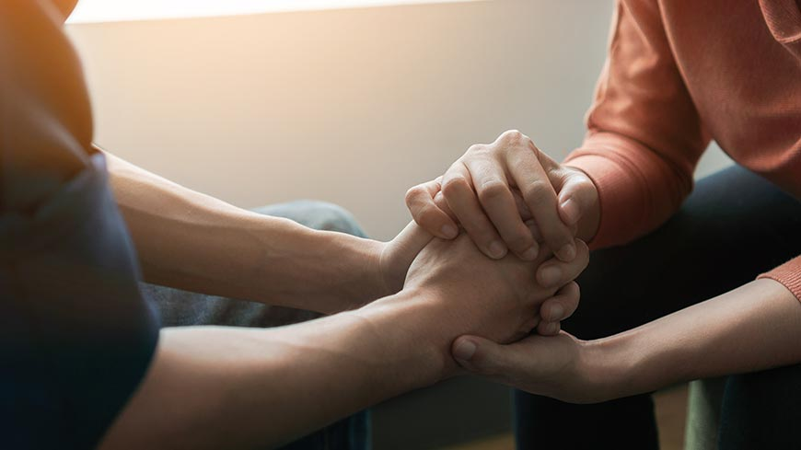
According to the Royal College of Psychiatrists, which represents 18,000 psychiatrists in the UK, more people are seeking crisis mental health services as a result of COVID-19

Slide 9
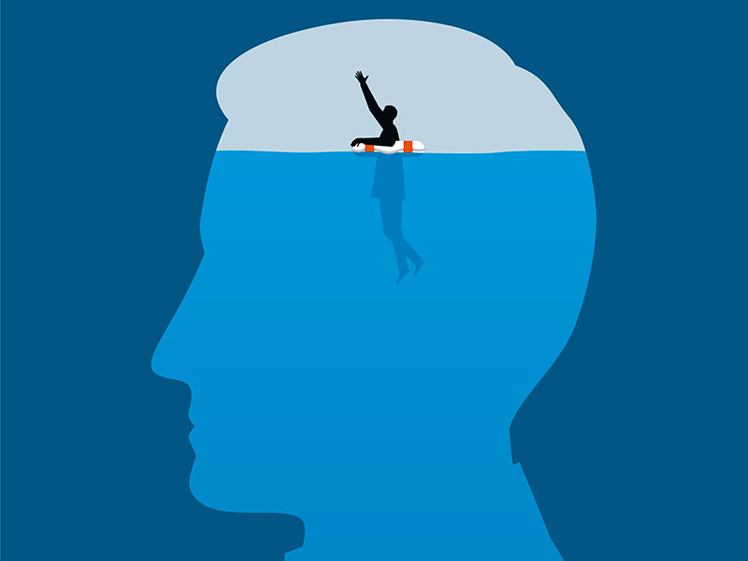
Stress
Everyone is under stress. COVID-19 has wrecked havoc within our minds and our bodies.

Slide 10
Post-Traumatic Stress Disorder
Sufferers of “long COVID” - who are still experiencing symptoms months after testing positive – also appear to experience mental health issues, which can be triggered by a range of factors including post-traumatic stress disorder (PTSD), lethargy, fatigue and olfactory disorders such as a loss of their sense of smell.

Slide 11
Major Changes within Families
Schools and universities closed down. Lessons and lectures were given online. This created great stress for parents, teachers and pupils.
Who uses the computer at what time and where?

Slide 12
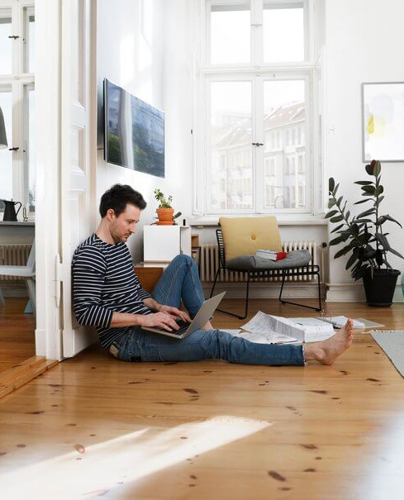
Living Alone
Living alone presents challenges at the best of times.
Many people living alone during the pandemic suffered greatly.

Slide 13
Living in a Dysfunctional Family
It was difficult for children experiencing physical abuse.
It was a difficult time for spouses living with abusive partners.
Some suffered hunger and even lost their homes.
Students dropped out of school, sixth forms, MCAST and university.

Slide 14

Lack of Structure and Routine
The pandemic has changed our routines.
Disorientation.

Slide 15

Cyberchondria
The abundance of unclear, inaccurate and ambiguous information during COVID-19 led to information overload and misinformation.
Information overload and fake news accelerated health anxiety. This is referred to as cyberchondria.
(Laato et al., 2020)

Slide 16
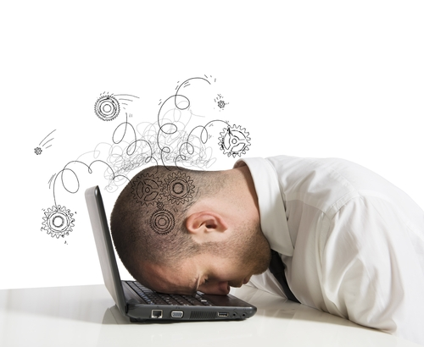
Social Media Fatigue
Compulsive social media use is one of the primary predictors of social media fatigue.
Social media fatigue can lead to anxiety and depression (Dhir et al., 2018).

Slide 17

Fatigue
Some slept more and some slept less.
Everyone feels tired.

Slide 18

There are many things we can do to safeguard our mental health and physical wellbeing.
The following ideas were taken from a resource which I found from St. Luke Institute, Manchester.

Slide 19
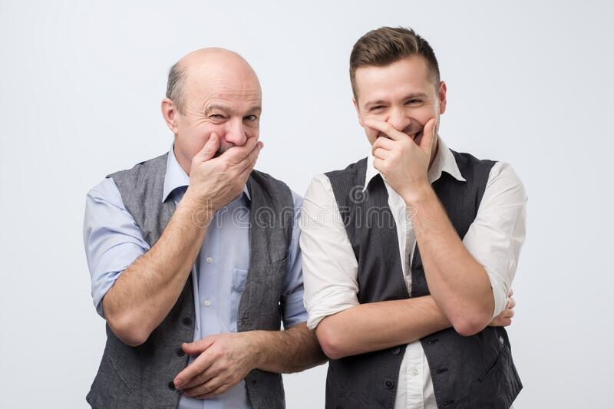
Laughter
Look for humour in everyday life.

Slide 20
Negative Thoughts
We hear negative comments like thunder and praise like whispers.
(Robert Wicks, 2009)

Slide 21

Take Control
Know what you can change and what you cannot.

Slide 22

Serenity Prayer
God, grant me the serenity...
To accept the things I cannot change;
Courage to change the things I can;
And wisdom to know the difference.

Slide 23
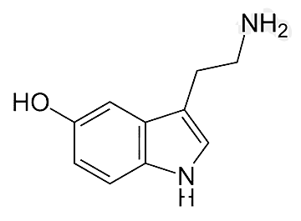
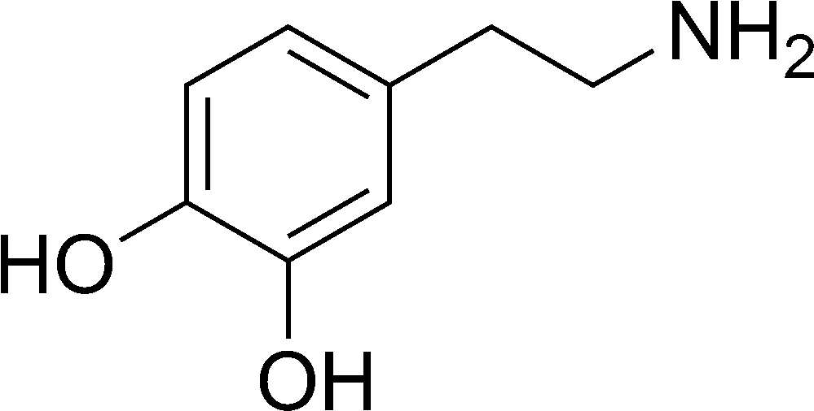
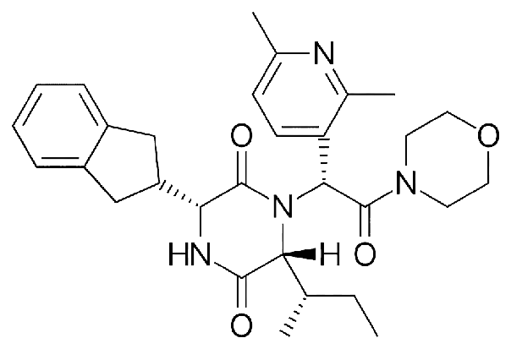
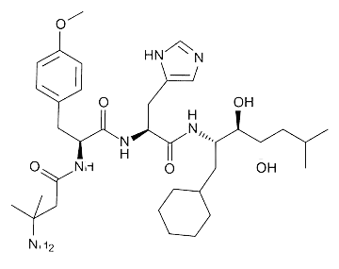
The Happy Hormones - DOSE
Dopamine
Serotonin
Oxytocin
Endorphins

Slide 24
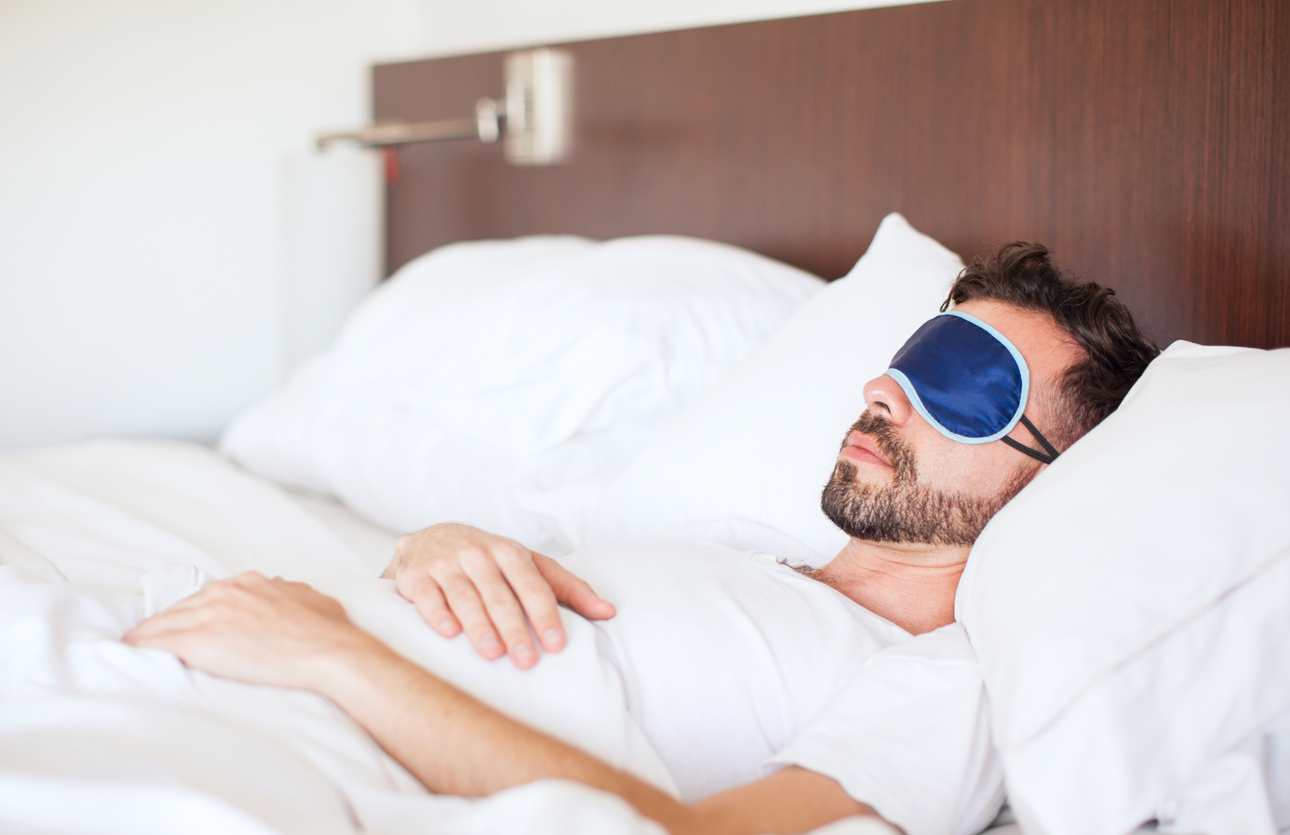



Physical Health
Thoughts
Food
Sleep
Exercise

Slide 25



Relationships
Connect with people everyday.
Have friends who can support you and challenge you.
Foster positive relations in your life.

Slide 26



Leisure
Find time for things like hobbies which are powerful distraction from daily routine and stress.

Slide 27

Gratitude
Reflect on the gifts and blessing you have been given.

Slide 28
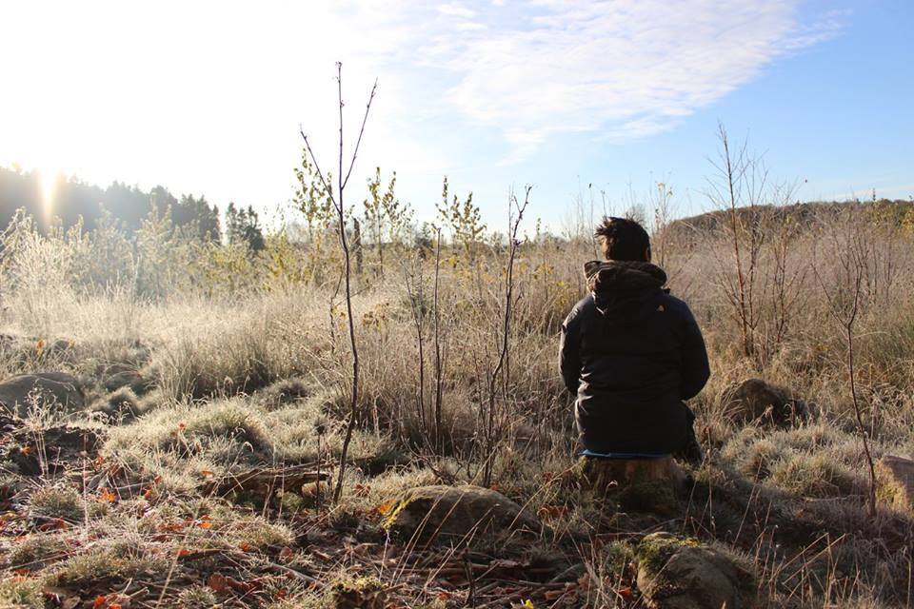
Slow Down
Slow down
Sit still in nature
Meditate
Centre yourself
Feel grounded
Pray
Be still

Slide 29

Prayer
Prayer Michel Quoist

Slide 30
Thank you.

