Slide 1
Promoting a Culture of Encounter: Sharing our Faith in Dialogue with Contemporary Society
Paul Tighe
Pontifical Council for Culture
16th June 2021

Slide 2
Context and Content
Church in society – cultural context
Church – beyond self-preoccupation
Church – in service of the Word, proclaim
Church – peripheries, suffering (marginalization/alienation), central?
Church in the World – giving and receiving
Pilgrim Church – brothers and sisters

Slide 3
Digital World
New Culture – relating, belonging, identity
Informational and Relational – Witness
Presence in a digital world – tone and intention
Language – style, mode and vocabulary (listen, converse, encourage)
Inculturation – Ricci, celebrate the positive, kerygmatic filter (speak the truth in love)
Drivers – connect, search (information and guidance), share, release (diversion/exceed)

Slide 4
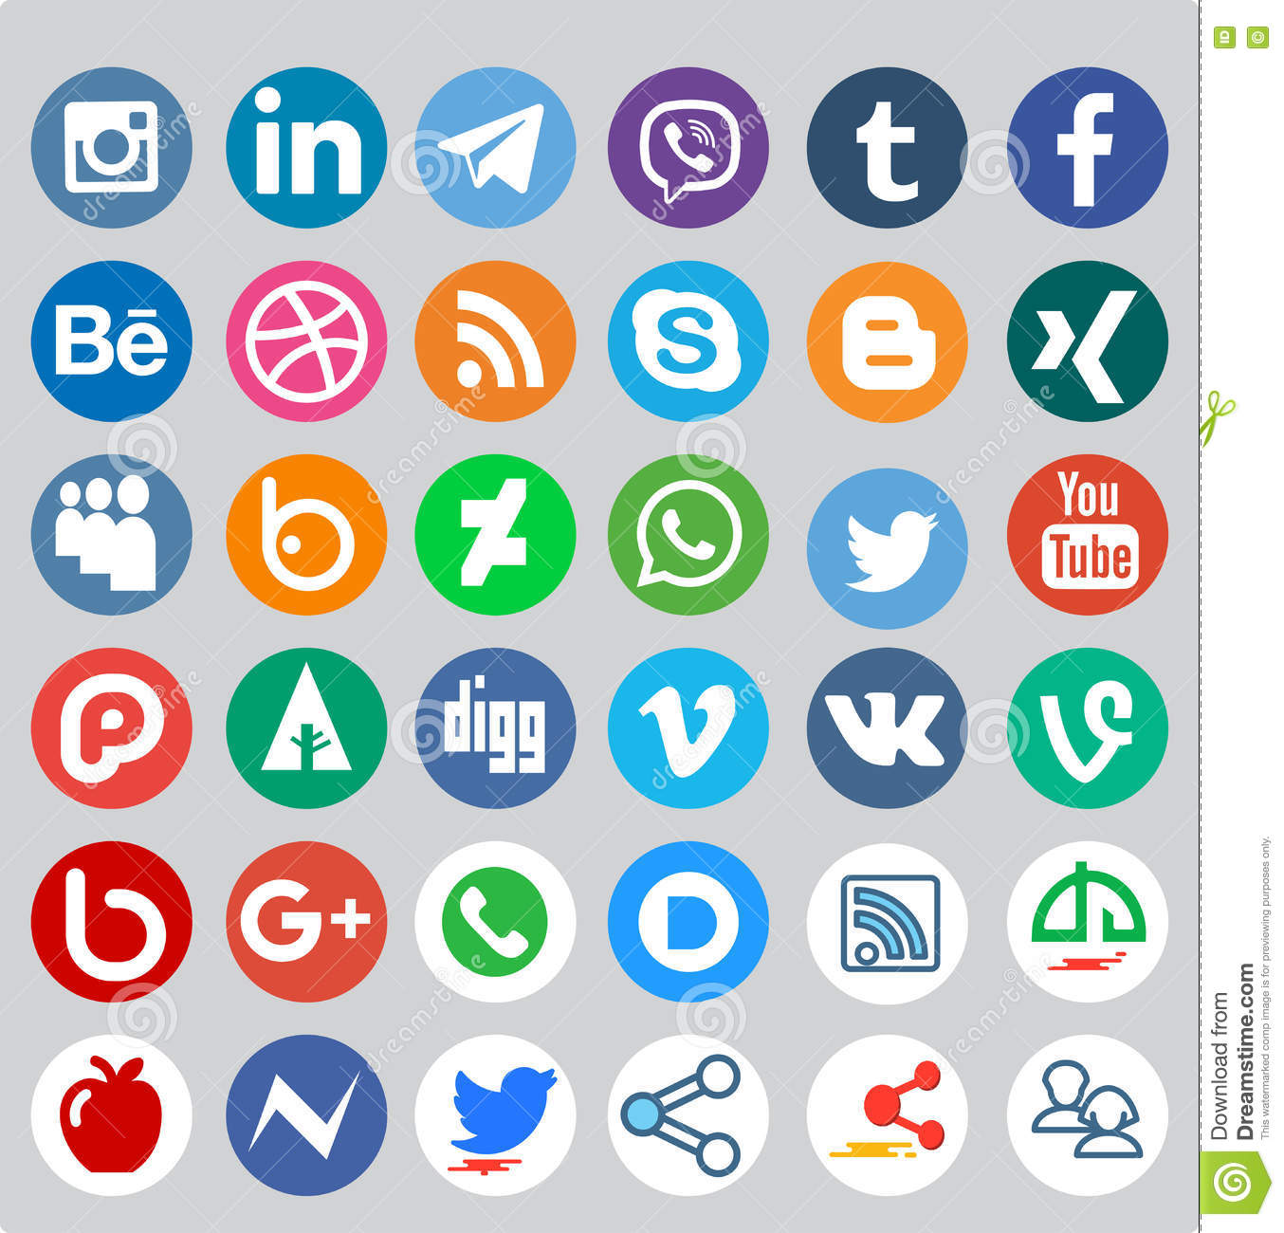
Points of Insertion

Slide 5
Connectivity
Friendship and Family
Anxiety and Fear
Risk – quantitative, shallow, swipe, distraction
Blessing – cultivate, focus, unconditional
Made in image and likeness of God- Trinity
Only with God
Sharing deepest joy – authentic
Respecting mystery

Slide 6
Search - Information
Information – trivial to profound
Reliability – verify, judge, evaluate (helpful)
Real answers – used or engaged?
Risk – numbers or emotional
Crisis – post-modernity, relativism
Discernment – dialogue and consensus, search for truth (natural law – as a process), inclusive
Truth – way, truth and life

Slide 7
Search - Guidance
Following – influencer (celebrity or expertise)
Authority – earned, conferred, vindicated
Trust – damaged, candour
Polarization – echo chambers, trapped
Awareness and responsibility
Encounter – openness to other, diversity as richness, antecedent willingness
Discipleship – follow me (lived verification)

Slide 8
Sharing
Gifting – time, talents, knowledge (commons)
Passion and enthusiasm – evangelizers
Collaborative platforms – apps
Risk - narcissism or performance
Worth – gratuity (inequality and meritocracy)
Mercy as disruptive – healing and hope
Community and common good
Church – haven (field hospital), Joyce
Love one another as I have loved you

Slide 9
Release
Portal/screen – opening to world (knowledge, art, entertainment, opinion)
Augments experience – ‘reading the internet’
Risk – distraction, isolation (attention)
Engagement – seriousness, issues (ecology), mindfulness
Art – shock, waken, unsettle (irony/humour)
Artists – listening (taking serious), barometer, friendship, life affirming (hope and truth)
Since someone will forever be surprising
A hunger in himself to be more serious (Larkin)

