Slide 1

Religion & Spirituality during the Covid-19 Lockdown
AN online survey 2020-2021
 | Faculty of Theology Department of Pastoral Theology, Liturgy and Canon Law

Slide 2
The Covid-19 Pandemic has upset our lives
Present pandemic has caused much heartache and hardship
By now we all have family members or friends who have contracted the virus
Worse yet, we might have family members or friends who have succumbed to it
Those of us who have not taken sick find that the virus has thrown our lives out of kilter

Slide 3
The Covid-19 Pandemic has changed our lives
We cannot easily work at the office or shop, or take undue risks
Many work from home. Others may no longer work at all
Our cities, streets and restaurants are deserted
We are now spending much more time at home with a lot of time at our disposal but which we do not know how to utilise

Slide 4
The Covid-19 Pandemic has put our life on pause
What are we to do?
Streaming movies and videos, playing online games, finding less excuses not to exercise
This pandemic has put our life on pause.
We have now more time to reflect on our lives

Slide 5
The Covid-19 Pandemic and Religion
The Covid-19 Pandemic has generated a lot of anxiety and mental health problems
Classical European literature mentions the possible roles of religion in responding to and coping with epidemics of contagious illnesses, such as the plague (Boccaccio 1353, Manzoni 1840, Camus 1947, etc)
How religions are coping with the Covid-19 pandemic is still early to tell

Slide 6
The Covid-19 Pandemic and Religion
There are however some studies which speak about certain factors:
Religious doctrinal responses
Religiously related behaviour
Prejudiced attitudes and behaviour towards religious groups
Tensions, strains and conflicts about religious matters

Slide 7
1. Religious doctrinal responses
A belief found in almost all religions is that the pandemic is not merely extraordinary but it marks an imminent apocalyptic change
However, this is found only in a small minority across all religions
Some Christians have taken a literal interpretation of the book of Revelation and of other biblical sources and quoting from internet believe that the end of the world will be preceded by a pestilence

Slide 8
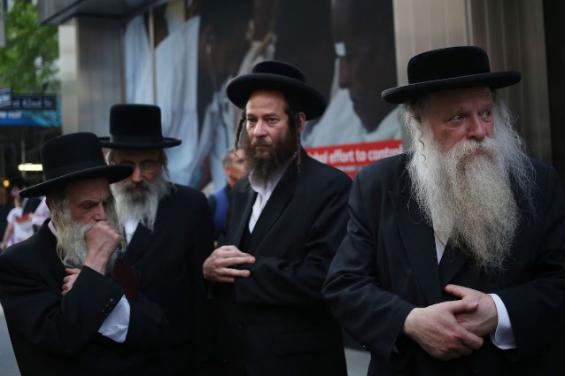
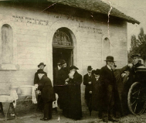
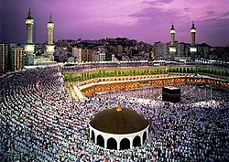
Religious doctrinal responses
There is evidence that some religious groups, Christian, Jewish, Muslim and Hindu have neglected health preventative measures and helped in the spreading of the infection
Such religious interpretations offer comfort on the one hand, but have been counter-productive on the other hand

Slide 9
2. Religious behaviour
The pandemic has affected religious practice insignificant ways:
  Cancellation of live religious services
  Closing religious schools
  Cancelling pilgrimages
  Prohibiting group interactions during festivals and celebrations
As an alternative, churches, mosques and synagogues have provided online streaming. In spite of this:
  Christians have been deprived of receiving the Eucharist
  Jews had to celebrate the Passover without guests
  Moslems were instructed to delay the Haj and pray at home

Slide 10
Is there a link between natural disasters and increased religiosity?
Prayer is a common way of dealing with adversity. When catastrophe strikes people seek closeness to God (Bentzen, 2019)
Religion can facilitate coping in situations beyond their control (Pargament, 1996)
There is evidence for the intensification of prayer activity during this pandemic (Coppen, 2020)
Searches for “prayer” on Google escalated in April 2020 and has doubled with every 80,000 new registered cases of Covid. Also searches for the terms God, Allah and Muhammed increased significantly
Benzen (2020) speculates that the Covid pandemic encouraged religious coping

Slide 11
Is this a shift from public to private prayer?
Prayer.com, the world’s n.1 prayer app and website has been highly successful in attracting new subscribers and revenue (Heilwell, 2020)
A Pew poll (Pew Research Center, 2020) – 55% of Americans prayed for the pandemic to end, including 15% of those who “seldom or never prayed”, and 24% who endorse no religion
On the other hand, the last 4 decades have seen a decline in religious affiliation. There is a speculation that in the UK there will be a further decrease in church attendance after the Covid for 3 reasons:
  Church goers, both lay and clergy are old and might not survive
  Foreigners cannot enter the country
  Once the habit of churchgoing is abolished it will be hard to take up again

Slide 12
The Gallup Report
“The most dramatic result (of the pandemic in religion) has been the exceedingly quick shift of religious services from in-person to online worship”
  19% of Americans reported their faith has intensified; only 3% reported it got worse (Newport, 2020)
  50% “prayed for an end of the spread of the virus”
  “attended religious services in person less frequently” and
  “watched religious services online or on TV instead of in person”
Religious activity has changed:
  Collective worship has become difficult
  Online worship is increasing
  Private worship/prayer appears to have been considerably on the increase

Slide 13
3. Prejudice
Some Christian and religious sources have suggested that pandemic is a punishment for sin, e.g. gay marriage, sexual immorality and abortion
More moderate faith leaders reject this idea as God is love
Some see it as a punishment against Jews, others blame the Chinese for their policy of State Atheism and persecution of Muslims
Prejudice against others is likely to increase distress and in some cases precipitate mental ill-health

Slide 14
4. Religious struggles
Major life crises have the potential to shake people not only psychologically, socially and physically but also religiously and spiritually resulting in religious struggles. These can take many forms:
  Feelings of anger toward, abandonment or being punished by God;
  Concerns that a trauma may reflect the work of the devil or demonic forces;
  Doubts about the truths of one’s religious faith;
  Questions about the ultimate meaning or purpose in life;
  Struggles with living up to one’s moral values; and
  Conflicts with other people about religious issues (Exline et al., 2014)
It is expected that the Covid crisis will trigger more of these struggles

Slide 15
Religious struggles and greater distress
A significant body of research has tied religious struggles to greater distress, psychological problems and physical decline including a greater risk of mortality (Pargament and Exline, in press)
Lee (2020) reported higher levels of struggle with God associated with elevated scores on a Coronavirus Anxiety Scale
One could expect a rise in Covid-19 related religious struggles among various religious groups and subsequent mental health related problems, including depression, anxiety, PTSD and suicidality

Slide 16
A Study with the Maltese Population
The initiative taken by the Department of Pastoral Theology to conduct an online survey using an anonymous questionnaire which could be filled by anyone.
This strategy intended to gather information about how people interpreted the COVID-19 pandemic and the partial lockdown in Malta.
The questions were meant to gauge the personal experiences of the respondents, how COVID-19 impacted their sense of existential meaning, their faith, their sense of community and how they coped with the crisis
Some of the questions in this survey were inspired by the above mentioned studies and by other surveys conducted elsewhere. Others targeted specifically the local situation.

Slide 17
The Questionnaire
The tool, an anonymous online questionnaire consisted of 43 questions and a number of sub questions. Apart from the demographic information, it covered 6 sections related to what are considered as classical dimensions of religion as well as other related areas:
Beliefs
Personal experience
Community
Ritual
Socio-cultural dimension
Way forward.

Slide 18
RESULTS
Section 1: Demographic Information
The number of entries was 1102, 385 Males (M) (35%), and 711 Females (F) (65%). These were subdivided into 5 groups according to age brackets and arbitrarily divided and labeled.

Slide 19
Education Level

Slide 20
Religious Affiliation
Catholic: Y 159 (72%) A 401(92%) M 216(91%) S 125(89%) R 66(97%)
No Religion: Y 44 (20%) A 21( 5%) M 13( 6%) S, 3( 4%) R 2( 3%)

Slide 21
Pre-Covid 19 Church Attendance

Slide 22
Church Attendance before Covid-19
Those who attend more than once a week are from the older groups. The Non-Graduates group (N=99) obtained similar results as the Y group

Slide 23
Personal Beliefs
Average: 98%

Slide 24
Personal Beliefs

Slide 25
Personal Beliefs

Slide 26
Personal Beliefs

Slide 27
Personal Beliefs

Slide 28
Personal Beliefs
44% took a neutral stance. For the rest, it was people in the younger age brackets and the retired who gave it high importance

Slide 29
Personal Beliefs

Slide 30
Personal Beliefs
29% took a neutral approach; 48% did not give it much importance; only 24% saw it as important

Slide 31
Personal Beliefs

Slide 32
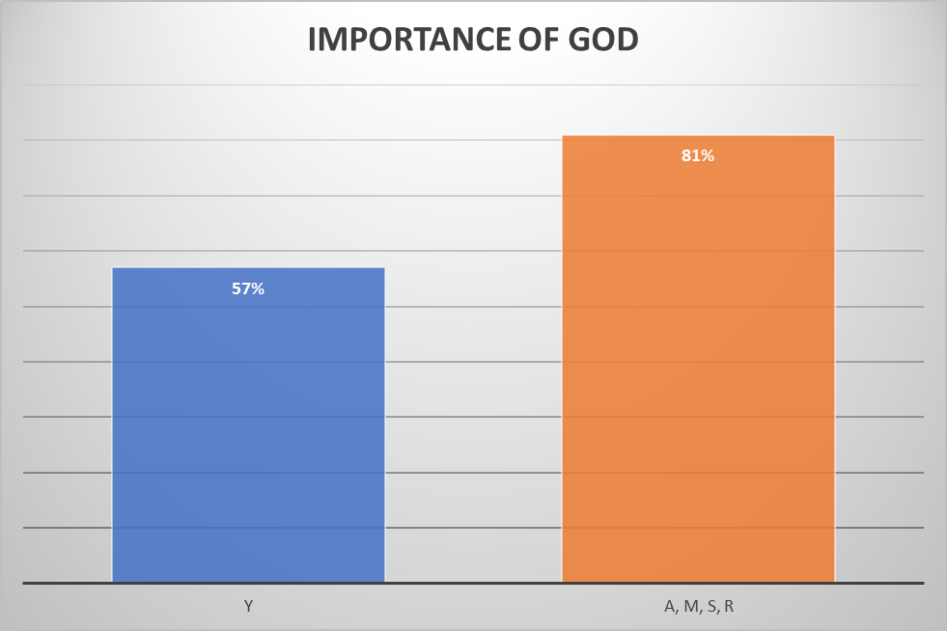
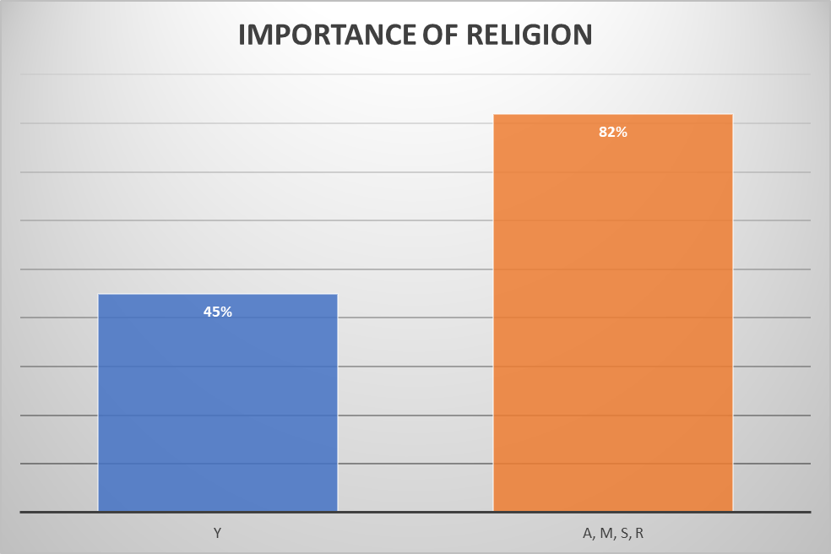
Personal Beliefs

Slide 33
Personal Beliefs

Slide 34
Religious Beliefs unaltered by Pandemic

Slide 35
Religious Beliefs unaltered by Pandemic

Slide 36
Religious Beliefs unaltered by Pandemic

Slide 37
Personal Experience

Slide 38
Relationships during the Lockdown

Slide 39
Relationship with God

Slide 40
Personal Experience: Prayer as Coping

Slide 41
Personal Experience: Prayer as Coping

Slide 42
Personal Experience: Religious Coping

Slide 43
Communitarian Dimension

Slide 44
Communitarian Dimension

Slide 45
Communitarian Dimension: Church Leadership

Slide 46
Ritual and the Pandemic

Slide 47
Ritual: Online Worshipping

Slide 48
Ritual: Places of Worship

Slide 49
Ritual: Online Worshipping

Slide 50
Socio-Cultural Dimension

Slide 51
Way Forward

Slide 52
Way Forward

Slide 53
Way Forward

Slide 54
Way Forward

Slide 55
Conclusions
In the course of this study some basic questions were raised:
1. Is there a link between natural disasters and increased religiosity?
2. Has there been a shift in religious behaviour, such as from public to private prayer?
3. Do these disasters lead to an increase in prejudice towards others, God included?
4. Did this pandemic trigger more existential conflicts and religious struggles?
5. How did isolation and social distancing effect relationships at home and in the community?

Slide 56
Conclusions
1. Is there a link between natural disasters and increased religiosity?
The results show that the majority of participants felt closer to God and prayed more
Many found prayer as a source of consolation
For the majority, Faith helped go through this experience
However, this was not the case with the younger generation who in their majority disagreed

Slide 57
Conclusions
2. Has there been a shift in religious behaviour, such as from public to private prayer?
The results have shown that the majority of participants made use of the media to worship
They liked celebrating from home
At the same time they do not think that churches (public worship) have become superfluous
They continue to see churches linked to their religious identity
Missed going to Church especially receiving the Eucharist
This, however, is not reflected in the responses of the majority of the youngest group

Slide 58
Conclusions
3. Do these disasters lead to an increase in prejudice towards others, God included?
Most of the participants did not attribute this pandemic to God’s intervention
As a result, their perception of God, whatever that was, and their feelings did not change
The majority did not attribute an apocalyptic meaning to the pandemic
Nor did they see it as a punishment for something
However, there was a stronger sentiment from the youngest group that this could have been some form of revenge by nature, and that humanity has become corrupt

Slide 59
Conclusions
4. Did this pandemic trigger more existential conflicts and religious struggles?
The results of this survey seem to show that participants remained fairly entrenched in their positions
Though raising a fair amount of anxiety and distress the pandemic did not seem to have triggered serious religious struggles
The majority actually felt thankful, hopeful and resigned
There was however, more awareness amongst the oldest group of the possibility of dying because of the Covid-19 than among the youngest group
This could have had a bearing on existential issues more than on the rest

Slide 60
Conclusions
5. How did isolation and social distancing effect relationships at home and in the community?
One major outcome of having to spend longer time at home was the (re)discovery of family life and rituals, such as playing games together, watching TV and maybe most importantly, to enjoy having meals together
Many of the participants looked forward to resume face-to-face contacts in their community
Despite this, it is not certain if this will be reflected in an increase in Church attendance as a good number do not intend to relinquish worshipping online
Many approved the restrictions imposed by the Church authorities on religious gatherings and 89% did not mind skipping the village feast

