Slide 1
The Priesthood and Ageing
Fr. Frankie Cini MSSP
Oct 2020

Slide 2
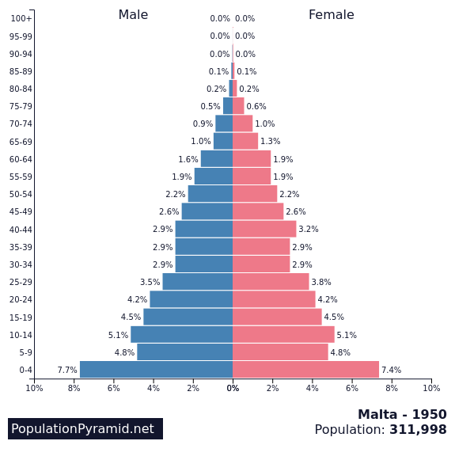
Life Expectancy in 1950: 64 years
Life Expectancy in 2019: 82.5 years

Slide 3
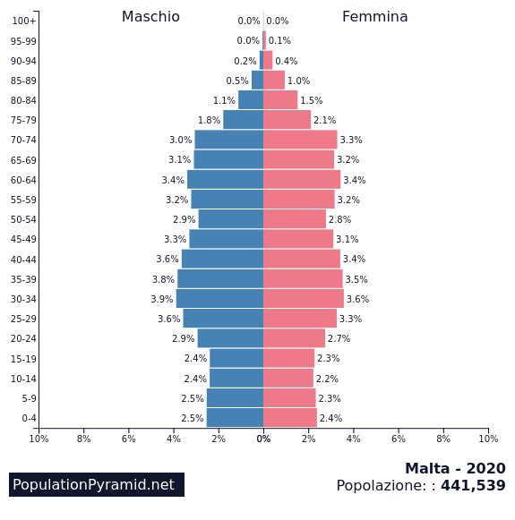
In 1980 the persons aged 65+ comprised 3.0% of the Maltese population, reaching 19.1 % in 2016. By 2070 it is projected to reach 30.6% of total population.
(Long-Term Pension Projections for Malta: 2016-2070, 2019)
https://population-pyramid.net/en/pp/malta

Slide 5
Diocesan Priests.
51.5% 152 priests in Malta are over 60. (N=287) (2020)
59.5% 94 of priests in Gozo are over 60 (N=158) (2020)
29% of priests in Malta and Gozo are over 75.
Male Religious
130 Male Religious are over 75
83 Male Religious are between 60 and 74

Slide 6
Starting from the basics: Physical Self Care
Diet, Rest, Exercise, Health Checks, Dental, feet,
The Geriatric Giants (Isaacs).
Instability (Falls).
Impairment of intellect
Incontinence,
Immobility
Iatrogenics. (polypharmacy).

Slide 7
Potential Adverse Health Outcomes
Falls
The unwanted effects of medication
Social isolation
Decreased Function
Poor Quality of Life
Hospitalisation
Institutionalisation
Death

Slide 8
Covid 19 consequences on Active Ageing and Retirement
Protecting vulnerable elderly priests: withdrawn from ministry as precaution
Loss of post retirement age professionals from the workforce
Isolation and loss of independence
Spike in anxiety, OCD behaviours and ideation

Slide 9
Retirement
The double bind of retirement
Life course events for priests are somewhat different from those of the general population.
Priests don’t do retirement well.
Spiritual arguments: this is a vocation for life, only death “retires me”
Not making way: impeding younger priests from assuming responsibility, with resultant loss of morale.
Workaholism vs despondency (uselessness)
Suggestions: Definite terms of office, official retirement age.
Transition processes: assuming different responsibilities. Mentoring.

Slide 10
adjustment to Aging (ATA)
Successful Aging : John Rowe and Robert Kahn (1987) 3 factors
Low risk of disease and disease related disability
High level of mental and physical function
Active engagement with life
Crowther et. al, added a fourth component. Positive Spirituality (2002)

Slide 11
Seasons of a Priests Life: Developmental Tasks
Generativity vs Stagnation
Workaholism
Despondency and cynicsm among the clergy.
Fulfillment
Integrity vs Despair
The happiness of priests (Rossetti, 2011).
Depression in the clergy (Kane, 2014)
Cumulative losses. Increasing frailty.
Beyond the 8th stage: Gerotranscendence and Wisdom
The shift to a ninth stage of development: Gerotranscendance, and Erikson’s 9th Stage.
(Erikson & Erikson , 1990)

Slide 12
Gerotranscendence
Lars Tornstam (1989) the final stage of Life Development c
Cosmic
Congruence
Solitude
Rajani, F. & Jawaid, H. (2015)

Slide 13
Spirituality, as liability
Unhealthy ways of using spirituality in old age
Extreme behaviours: Not having medication.
Saying faith alone should heal you.
Magical thinking leading to lack of self care:
“Trust in God, but tie your camel first.” (Muslim proverb).
The greatest fear about dying is that we will lose control over the circumstances stances of our dying and be forced to endure pain, suffering, and indignities we did not choose. Many more people fear this than fear death itself (Atchley and Barusch 2004).

Slide 14
Relative to advanced old age, subjective well-being may be indicative of gerotranscendence. Joan Erikson (1997) equated gerotranscendence as the ninth stage of psychosocial development. During this developmental period, exceptionally old persons may experience significant physical and mental decline followed by a significant loss in autonomy, increased dependence on others, and increased feelings of despair. However, Tornstam (2005) theorized that persons in exceptional old age typically remain emotionally connected to humanity, retain an affinity for the past, seek redefinition of self in space and time, prefer solitary or meditative moments, and lack concern for material possessions. This suggests that evaluation of subjective well-being requires sophisticated measurement instrumentation to capture transcendent dimensions of living an exceptionally long life
I am told that even spiritual leaders in many areas of the world have responded with physical withdrawal from the overbusy schedules of monasteries and convents. Perhaps the really old find a safe place to consider their states of being only in privacy and solitude. After all, how else can one find peace and acceptance of the changes that time imposes on mind and body? The race and competition are over and done with.

Slide 15
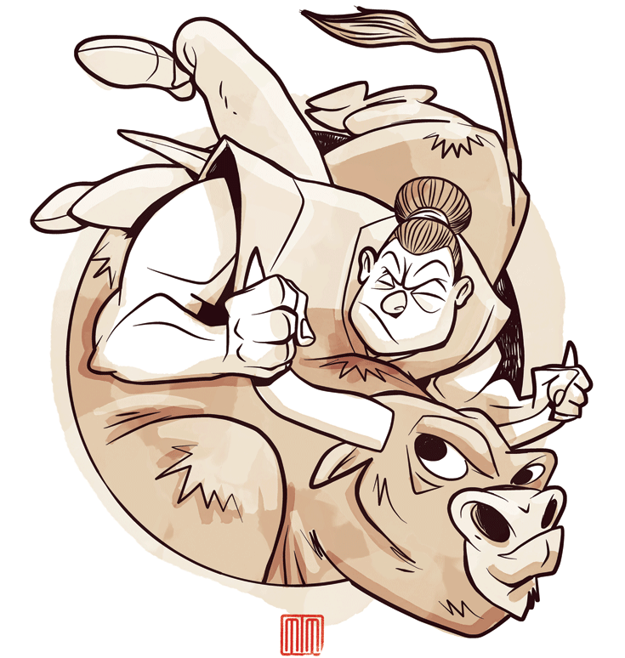
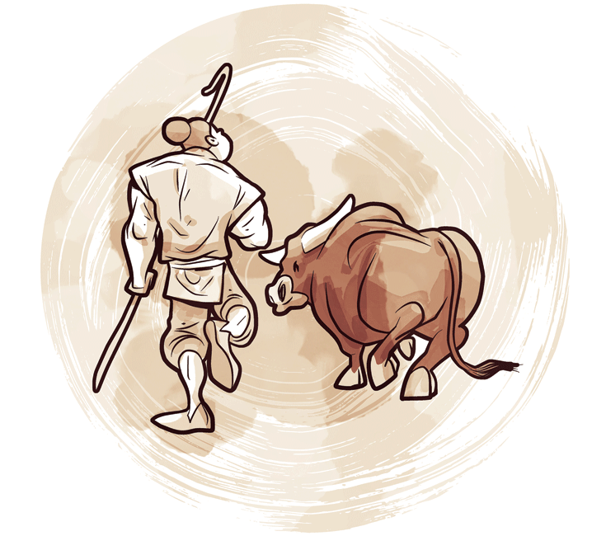
Becoming a Sage
What is a normal goal to a young person becomes a neurotic hindrance in old age. —Carl Jung
No wise person ever wanted to be younger. —Native American Amorphism
In the stages and processes through which aging people develop into sages we get a glimmer of the internal processes that complement the theory of gerotranscendence (Atchley 2003). To become a sage is to manifest wisdom and calm judgment. To become a spiritual elder is to be a sage in the role of elder-ing. Becoming a spiritual elder is also an evolution that couples being and transcendence with action in social roles. (serving from spirit).
Many of the most spiritually developed human beings are older men and women. (Atcherly 2008)
Erik Erikson initially thought that the major psychological task of old age was to develop ego integrity and thus avoid despair in the face of aging and death (Erikson 1955). But in his eighties, Erikson changed his mind. Wisdom culminating development of old age, and wisdom was reached by understanding derstanding that integrity and despair coexist (Erikson, Erikson, and Kivnick 1986). The wise individual understands that was the integrity balances despair and that despair tempers integrity. Wisdom thus transcends both integrity and despair. This type of transcendent perspective grows out of years of contemplating plating deep questions.
Atcherly, R., Spirituality and Aging. (2008)

Slide 16
Ageing with Grace.
Developing a willingness to deal with life completion and overcoming denial that we are aging.
Coming to terms with our mortality.
Acquiring the skills for working on our inner life by practicing journaling, meditation and spiritual intimacy in safe and sacred gatherings.
Paying attention to our body, feelings, mind, and spirit, being guided by them and maintaining them in the right tone, mood, and attitude.
Giving a real hearing to the inner voices – allowing all the minorities within the whole person their witness.
Beginning to do life repair:
  in health
  in practical matters with wills and testaments
  in relationships and between generations
  by reaching into the past to heal lingering wounds
  through forgiveness work to release past hurts
  by finding the pearls in the anxious memories
Doing the philosophical homework by raising questions about the purpose and the meaning of our lives.
Serving as elders to others as guides, mentors, and agents of healing and reconciliation on behalf of the planet, the nation, and the family.
Preparing for a serene death and afterlife, furnishing our solitude with Spirit.
Doing this nobly in connectedness with the inner self, already realized, individuated, and complete.

Slide 17
Frailty
DIFFERENT FROM ACTIVE Ageing
An acceptance and embracing of fraily and death as part of life.
Studies have found that for many clergy and religious their well being is tied to the fact that they do not embrace the cultural paradigm of successful aging linked ot independence. Instead the model of aging is one of acceptance of meaningful decline in which old age is seen as a normal part of the life course. St Luke’s 2020, Lagan,
Positive emotions correlated with longevity
This study found a very strong association between positive emotional content in autobiographies written in early adulthood and longevity 6 decades later. Such a finding is congruent with other studies by investigators that have found relationships between longevity and emotion-related concepts. Features of the current study differ from other studies that have investigated relationships between emotion-relevant behaviors and longevity or mortality and may account for the strength of the relationship observed in the current study: the population sample and the technique used to measure emotion. Our findings are compatible with recent longitudinal studies that suggest that optimism is associated with longer life (Maruta et al., 2000; Peterson et al., 1998),
54 percent of the happy nuns reached 94, 15% only of the less happy nuns did.

Slide 18
A deep and final generativity: giving our deaths away.
Saint John Paul II and Benedict XVI
Approaching Death
We leave this world, we can be what we have given. Death, from this perspective, can be made our final gift. We believe it daily, but is it not possible, that by living our lives, we create something fit to add to the store from which we came? Our whole duty may be to clarify and increase what we are, to make our consciousness a finer quality. The effort of one’s entire life would be needed to return laden to our source. Ron Rolheiser. Insane for the light (2020).

Slide 19
Can this epidemic change how society thinks about death?
For many people, this will have been an opportunity for an unprecedented reflection on death, which seemed to be "hovering" over us in these recent weeks.
More than usual, we have come to realize that we are mortal and that, consequently, life is precious.
This is the very function of death: to remind us how important life is. If people were not mortal, they would not be creative!
Hopefully, this sort of thinking will continue after the epidemic, and death will regain its place in our society.
Ever since the end of the Second World War, technical and scientific progress has led to a real denial of death. We have gradually forgotten that we are mortal, and the fantasy of eradicating death is more present than ever, with trans-humanism. Marie de Hennezel (May 2020).

Slide 20
Further reading
Ronald Rolheiser. R. (2020): Insane for the light. (online).
Chittister J. (2008). The gift of years
Castel A. (2020)Better with Age
Gawande A. (2014) Being Mortal.
Levitin D. J. (2019): Successful Aging
Bianci E. (2017). La vita e gli anni
Hennezel M. de. (2011). Seize the Day: How the dying teach us to live
Le Priol M. (2020) Old Age a journey to the inner self: (online)

